Slide 1
What is scrum/agile: Agile is a mindset, a way of work that allows product creators to easily adjust to stakeholders and users needs. Scrum is a project execution framework, applies agile principles, where the main focus is on team interaction over processes..
Main Principles of the Agile Methodology:
Customer satisfaction through early and continuous delivery of business value.
Continuous adjustment to ever-changing requirements.
Close working relationship with all involved (business people, technology developers, end users, customers).
Project teams are built around trusted and motivated individuals
Self-organizing teams.
Working components (ex: software) is the primary measure of progress.
Continuous attention to technical excellence and great design.
Simplicity of systems – the art is minimizing work and maximizing value.
Continuous adaptation to changing circumstances.
Continuous Improvement.
Accountable to each other.

Slide 2
Scrum team composition:

Slide 3

Scrum team Roles and Responsibilities:
Gathers input from Customers, Executives, users
Clearly stating Product Backlog items based on Customers feedback.
Determines what needs to be built
Prioritizes the Product Backlog to best achieve goals
Ensuring that the Product Backlog is visible, transparent, and clear to all
Shows what the Scrum Team will work on next
Development team is not to work on any other work other what it has been agreed by PO
Provide technical solutions
Determines how the solution will be built based on best technological practices
Is a cross-functional team (all skills required to complete the work to make the product
“shippable”. Tech Lead, Business Analysts, QA resources are part of the Development team.
Self-organizing. They select what they will be working based on the sprint backlog.
Accountability belongs to the entire team, not individual team members.
Development Team
Responsible for ensuring Scrum is understood & assures the team adheres to scrum practices and rules, scrum activities and cadence.
Ensure Product owner/Tech Lead create the product backlog and that is visible to the team and others.
Facilitates scrum events & assist team with removing impediments
Coaches team for continuous improvements
backlog to maximize value
Assist on organizational changes that increases the scrum team productivity
Maintains scrums artifacts (Burn down charts, Velocity Trend, Say/Do Ratio)

Slide 4

Tech Lead - Responsibilities
Collaborate with Product Managers and the rest of the team to ensure the backlog is fleshed out for the next development iteration
Tech lead thinks ahead, anticipates risks, and addresses them before they become a bottleneck for the team.
Works with the scrum team to debug code and assist the team on finding technical solutions
Identify and clear technical blockers for the team.
Coach the development team on best technical practices
Ensures that the team delivers great software solutions
Collaborate with the team to design features
Collaborate with Infrastructure team to ensure the developers have the right hardware to get their job done
Manages technical debt in effective ways to ensure it doesn’t accumulate to the point that prevents the team from moving forward.
Sounding board for their developers, the voice of Engineering to other business functions, and make critical technical decisions that can make or break a project. Ensures that the team delivers great software solutions
Work with other scrum teams to determine built dependencies and coordinate with Product Owner dependencies on release schedule/dates.
Work with the enterprise architect set up the built strategy. Ensure scrum team understands the built process/strategy. Coordinate and assist on code deployment.

Slide 5
Scrum Events, Cycle & Artifacts

Slide 6
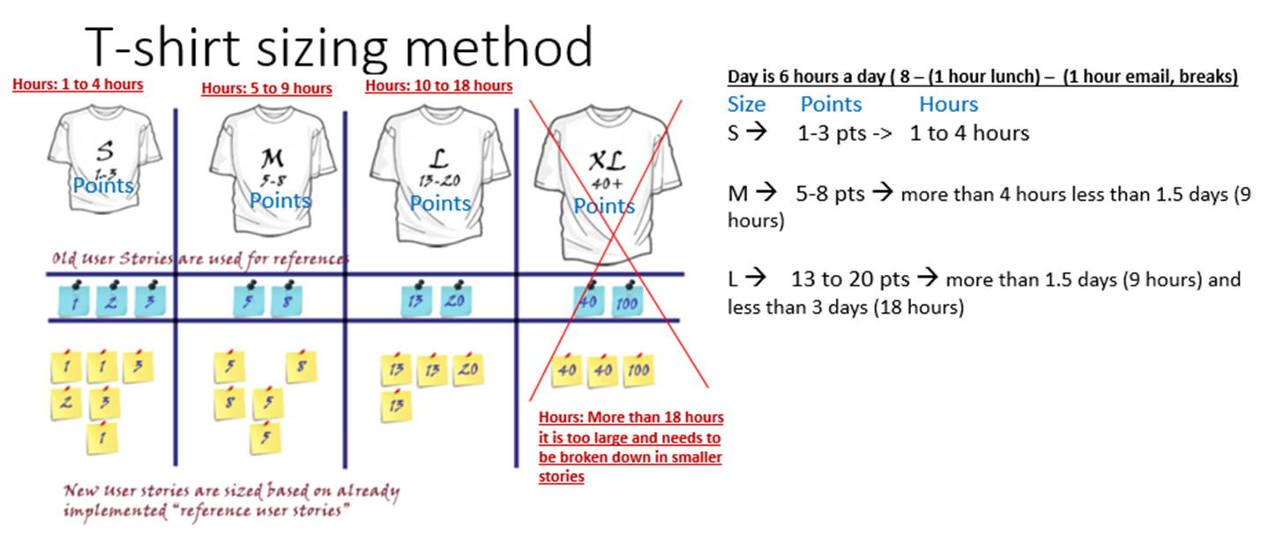
Stories Sizing (effort in Hours and Points)

